Slide 1
HOUSE PRICE PREDICTION PROJECT
Tdata TEAM
Florence – florencemayo11@gmail.com
Innocent – innocentalfred012@outlook.com
Bariki – bariki.elilaki@gmail.com
George – lucasgeorge1000@gmail.com
Raymond – raymondalick@gmail.com

Slide 2
OUTLINE
Explanatory Data Analysis
Data Cleaning & Imputation
Modelling & Prediction
Conclusion

Slide 3
EXPLANATORY DATA ANALYSIS
Categorical Data Analysis
Numerical Data Analysis

Slide 4
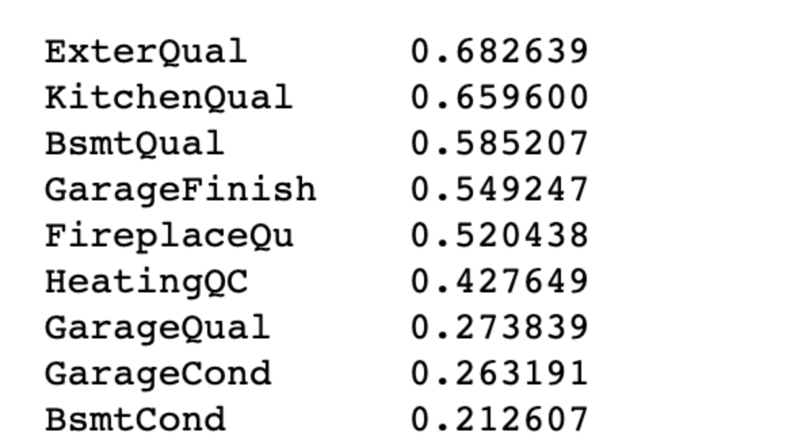
CATEGORICAL DATA ANALYSIS

Slide 5
CATEGORICAL DATA ANALYSIS

Slide 6
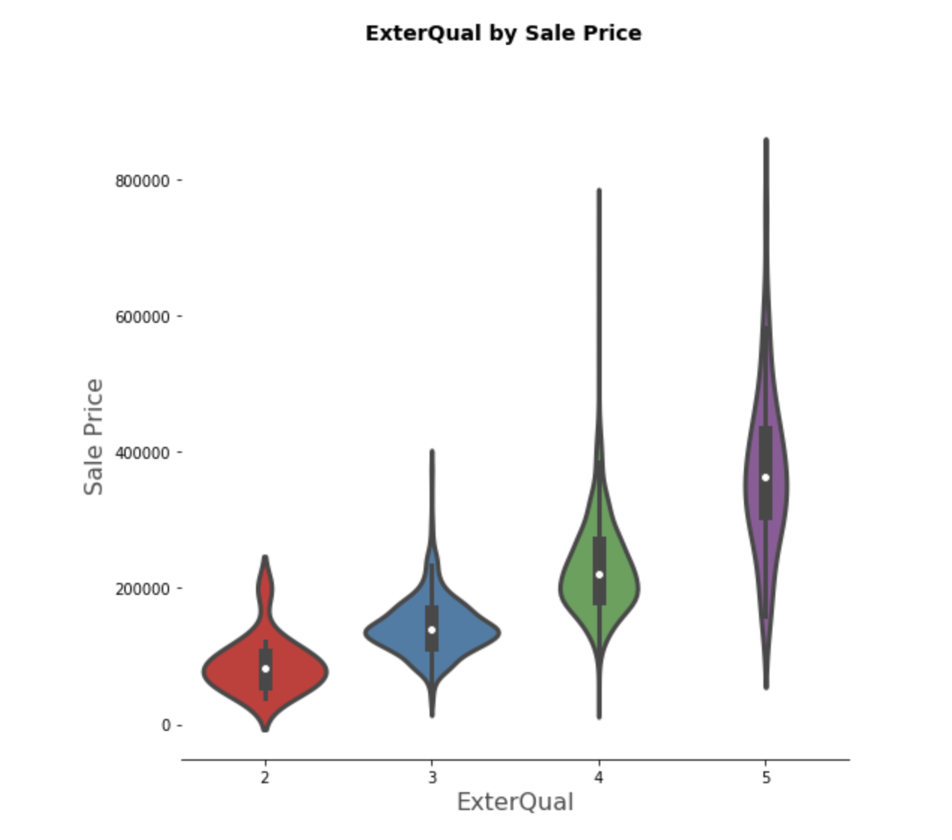
CATEGORICAL DATA ANALYSIS

Slide 7
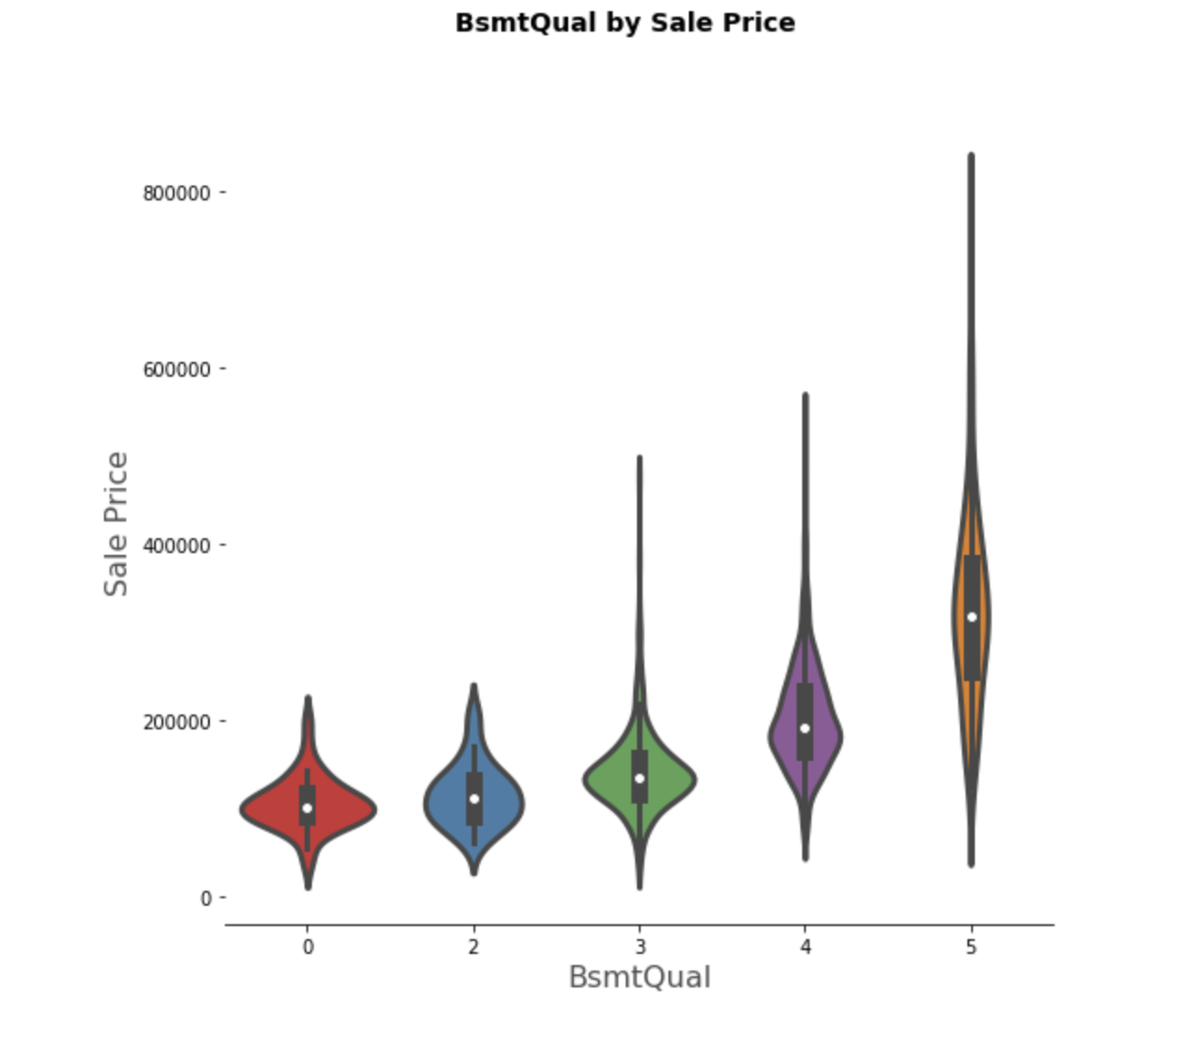
CATEGORICAL DATA ANALYSIS

Slide 8
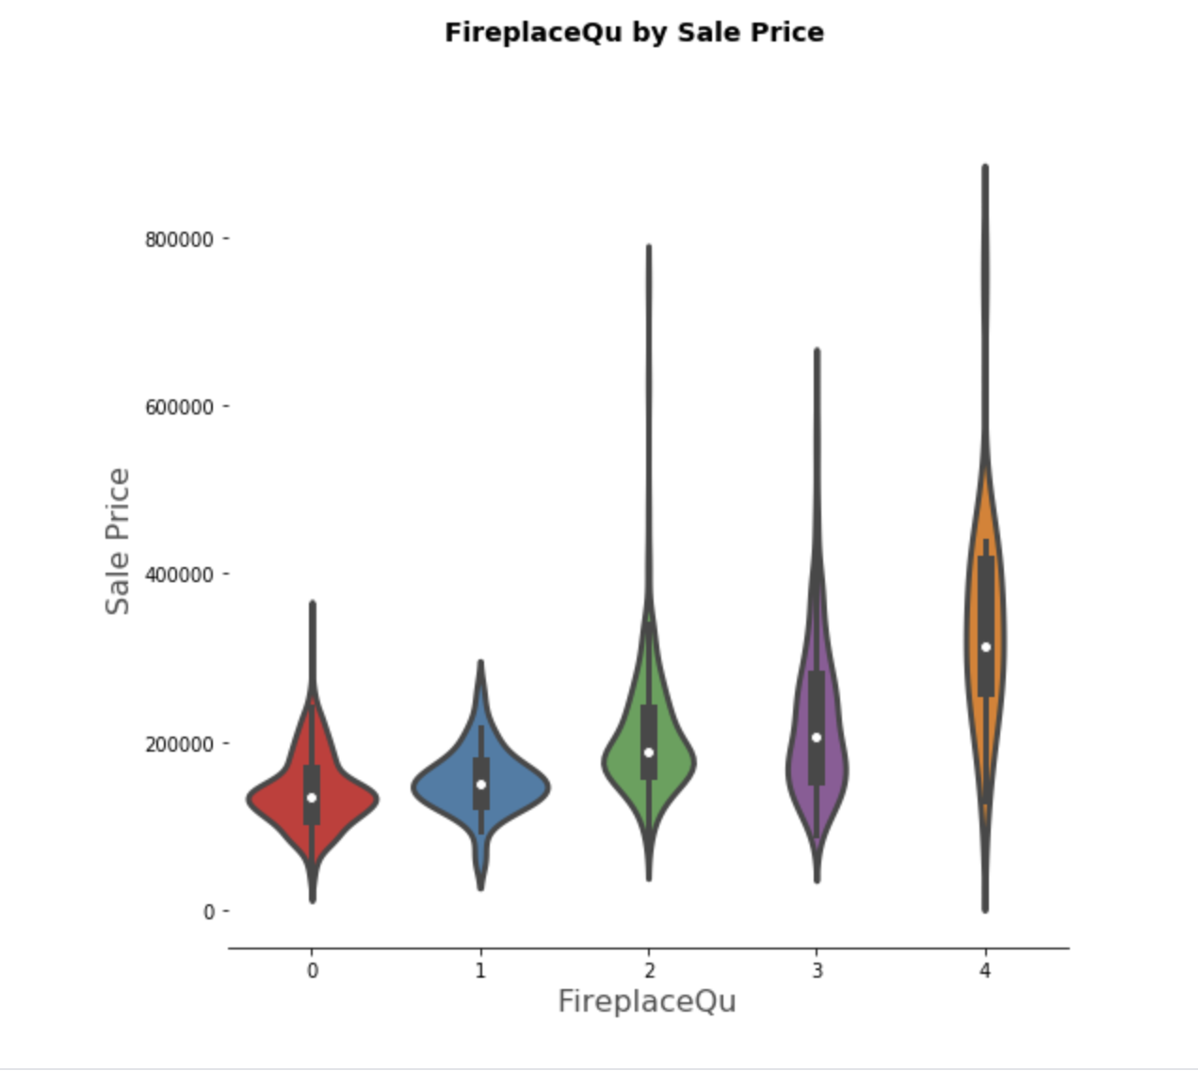
CATEGORICAL DATA ANALYSIS

Slide 9
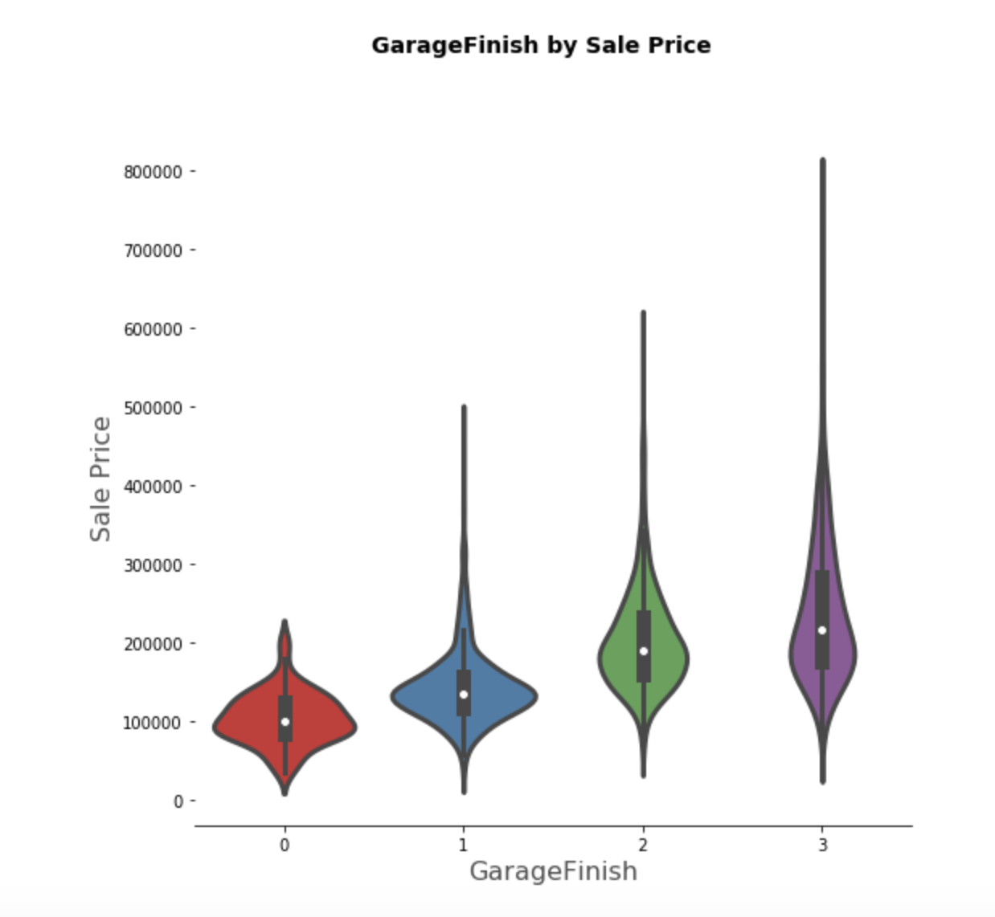
CATEGORICAL DATA ANALYSIS

Slide 10
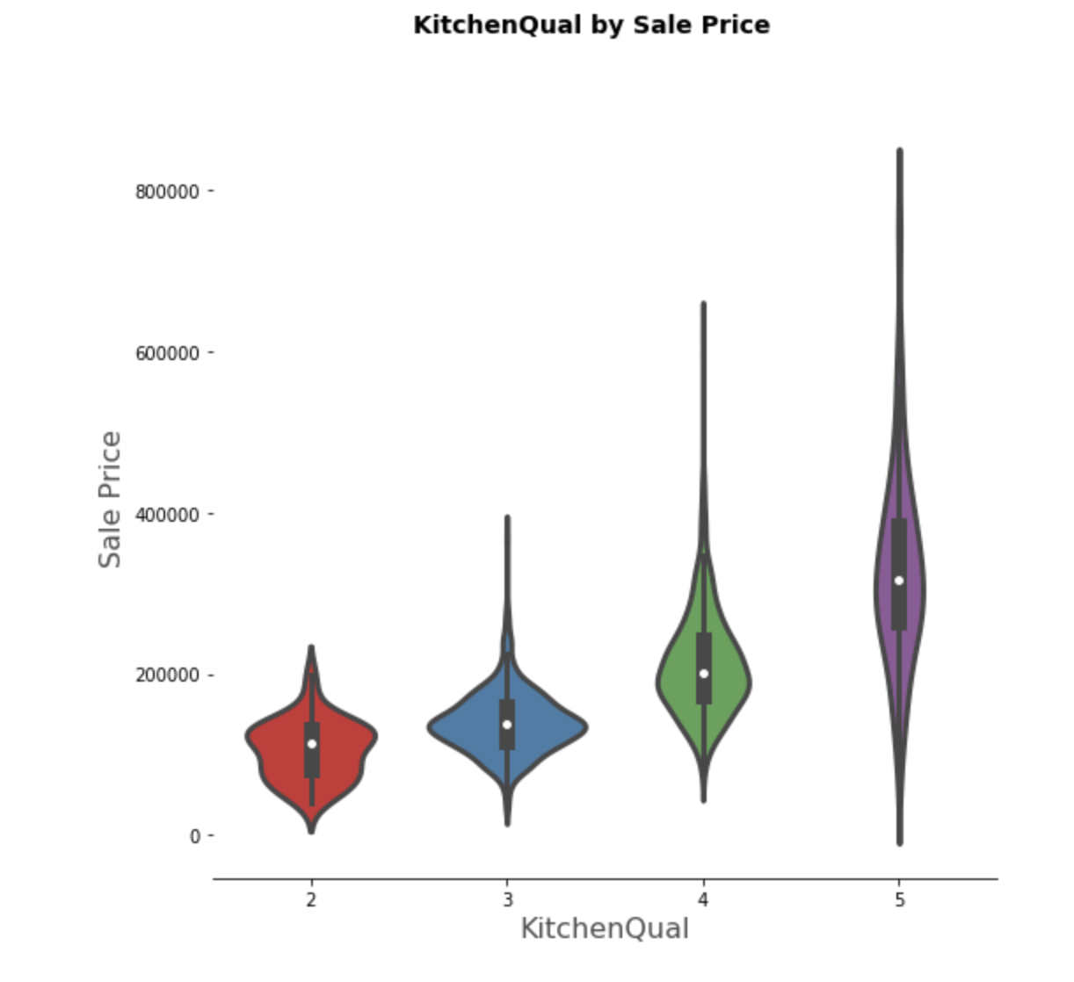
CATEGORICAL DATA ANALYSIS

Slide 11
NUMERICAL DATA ANALYSIS
Information that is measurable
Data represented as numbers and not words or text

Slide 12
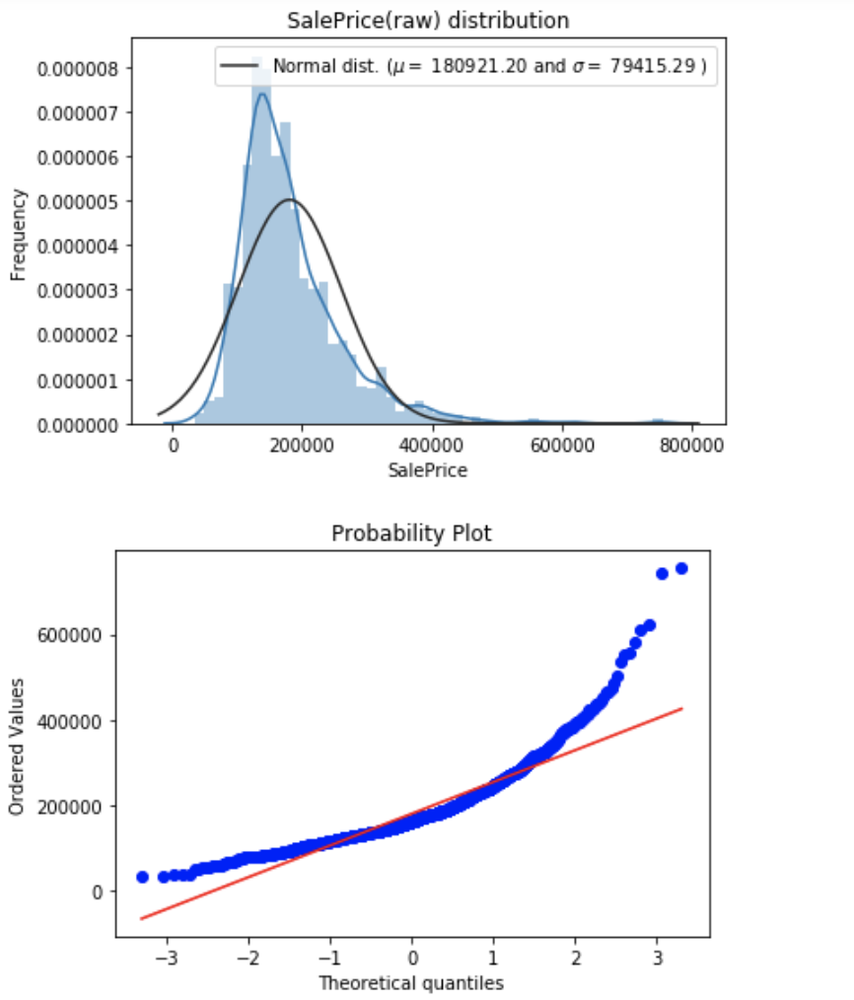
NUMERICAL DATA ANALYSIS

Slide 13
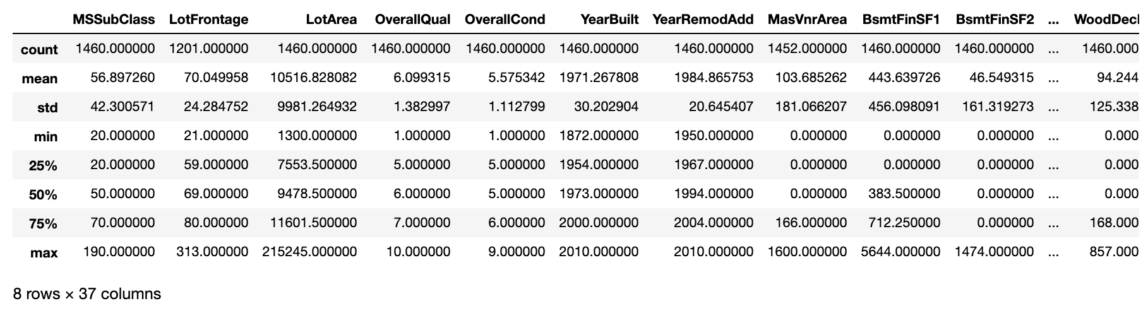
NUMERICAL DATA ANALYSIS

Slide 14
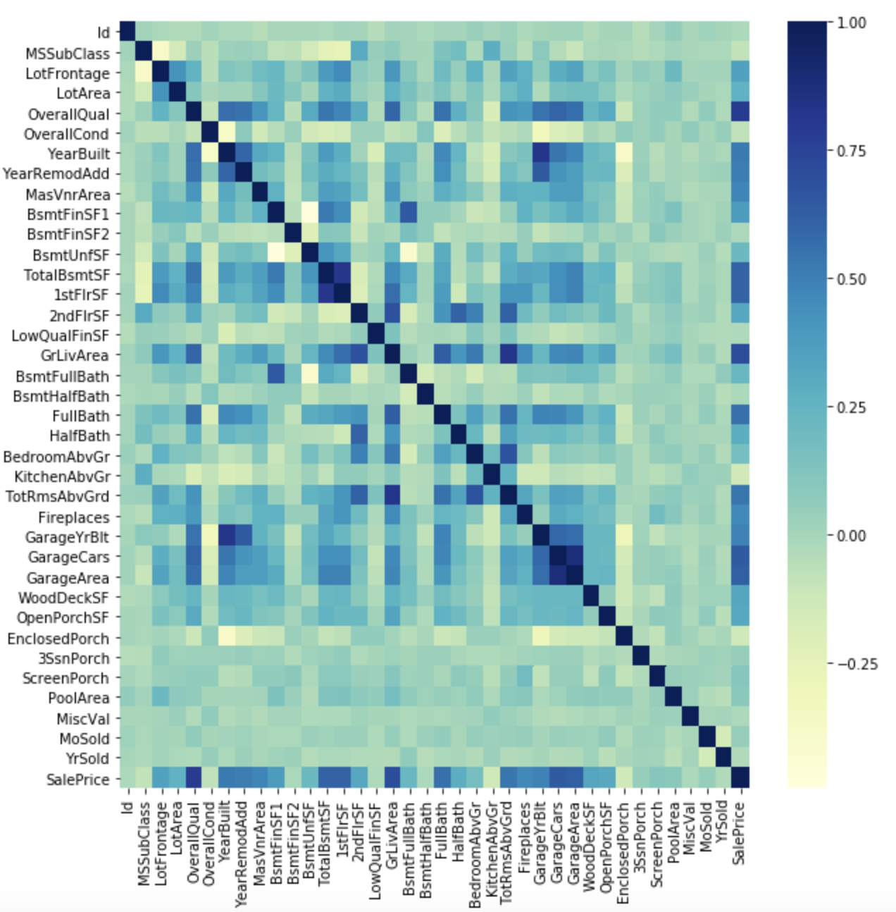
NUMERIC CORRELATION MATRIX

Slide 15
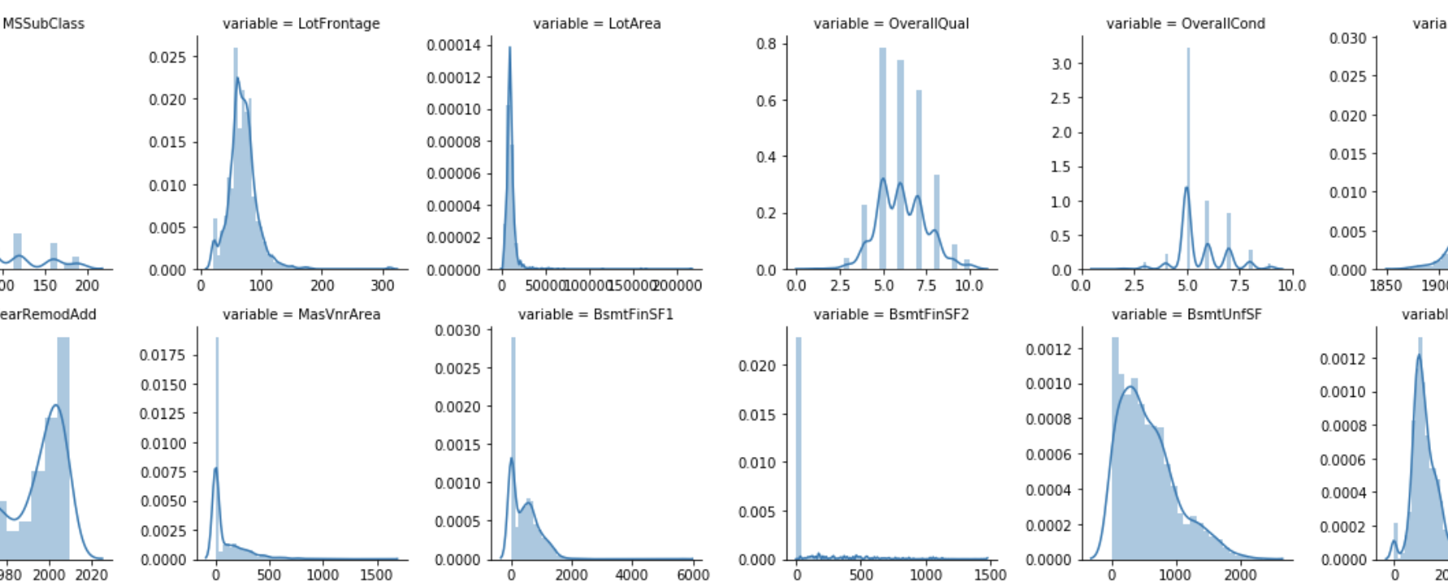
NUMERICAL DATA ANALYSIS

Slide 16
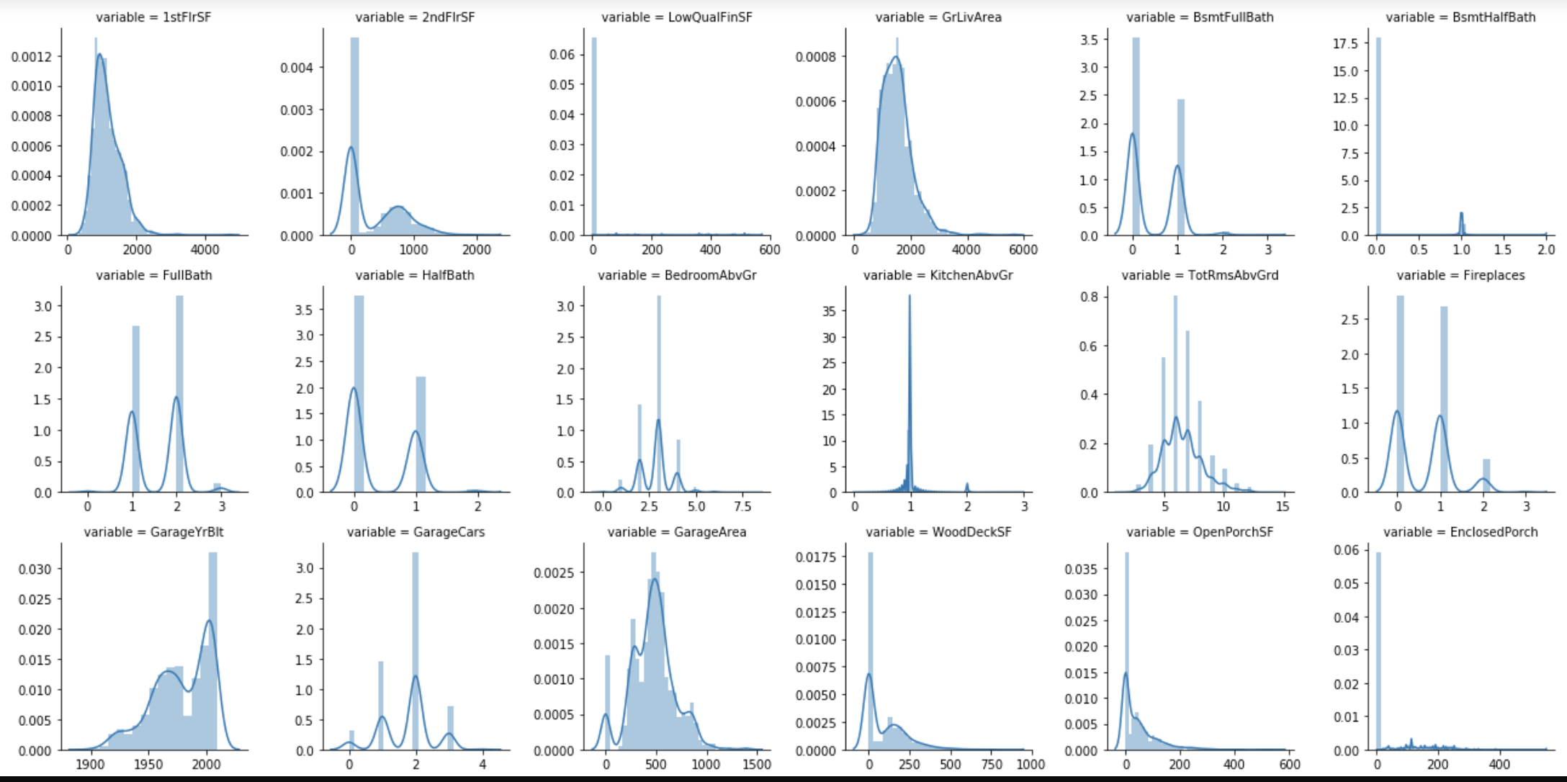
NUMERICAL DATA ANALYSIS

Slide 17
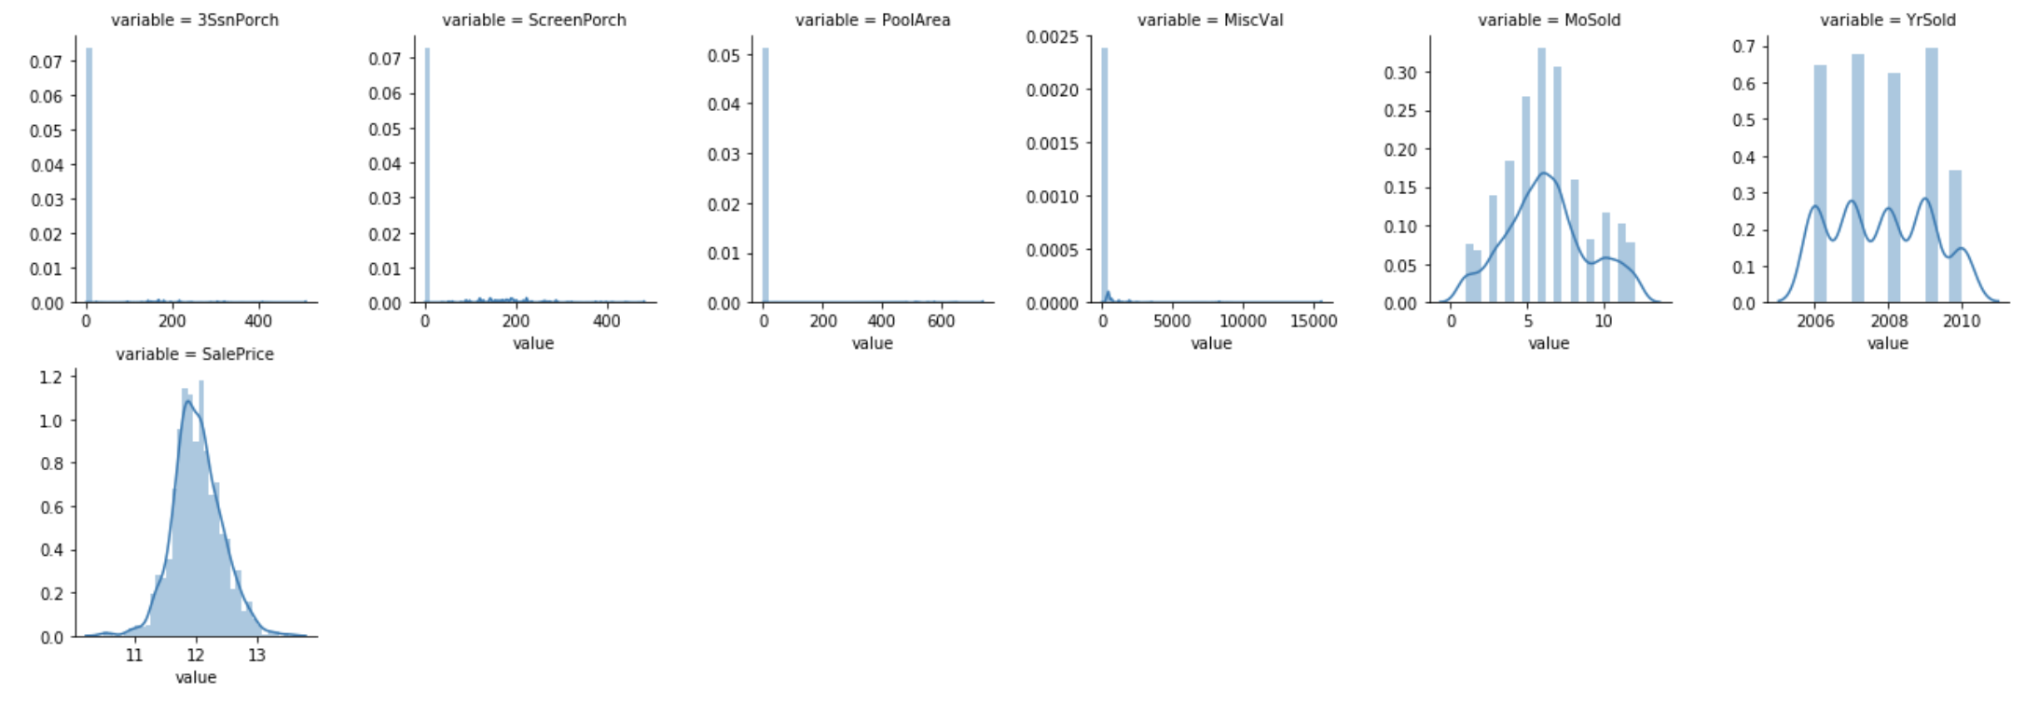
NUMERICAL DATA ANALYSIS

Slide 18
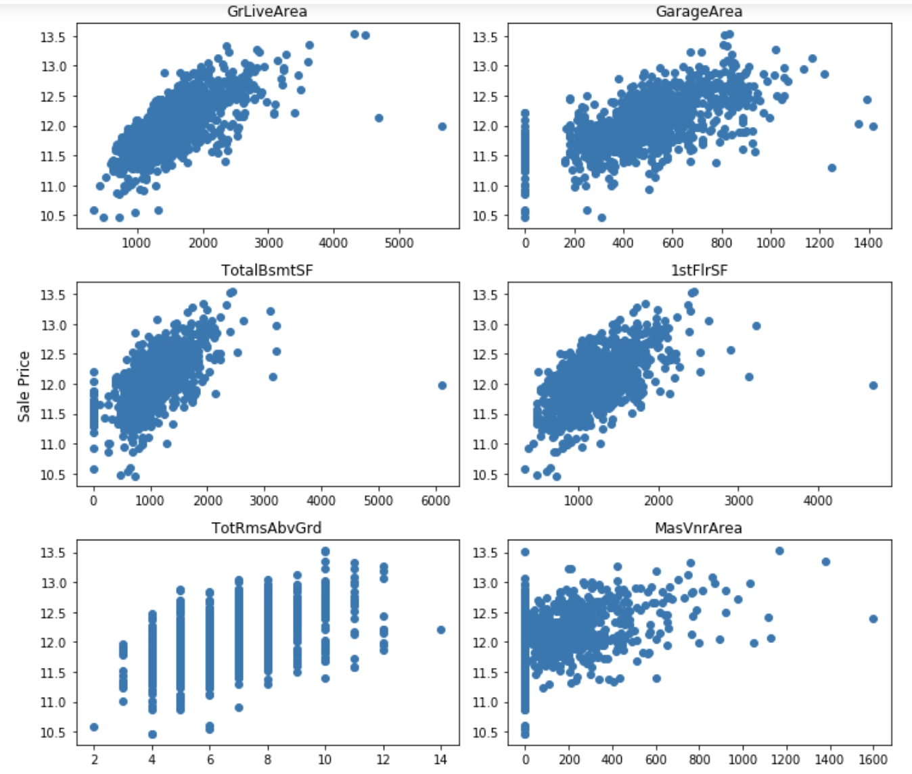
NUMERICAL DATA ANALYSIS
.

Slide 19
DATA CLEANING & IMPUTATION
Checking Missing Value
Imputation

Slide 20
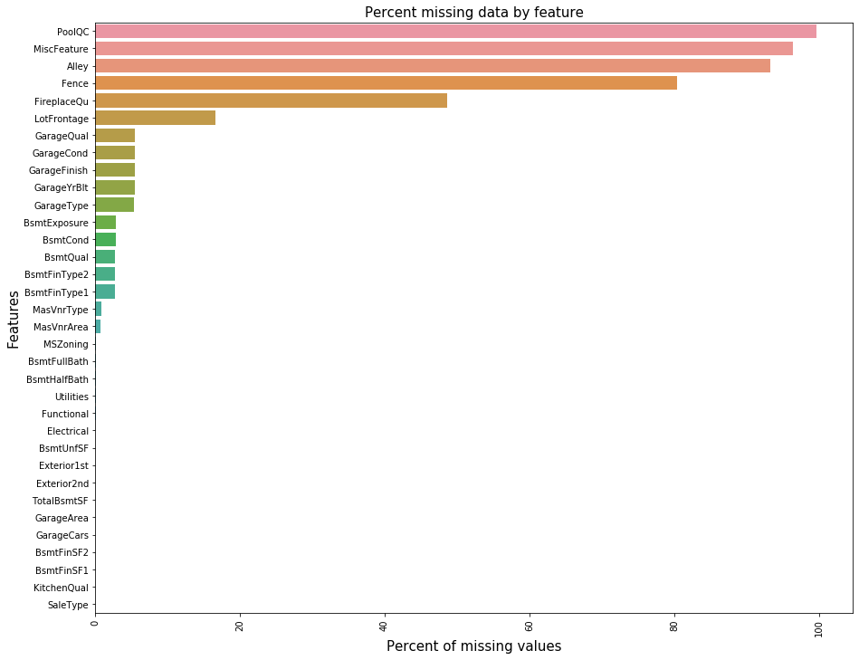
ANALYZE MISSING VALUES
PoolQC | 99.657417
MiscFeature | 96.402878
Alley | 93.216855
Fence | 80.438506
FireplaceQu | 48.646797
LotFrontage | 16.649538
GarageQual | 5.447071
GarageCond | 5.447071
GarageFinish | 5.447071
GarageYrBlt | 5.447071
GarageType | 5.378554
BsmtExposure | 2.809181
BsmtCond | 2.809181
BsmtQual | 2.774923
BsmtFinType2 | 2.740665
BsmtFinType1 | 2.706406

Slide 21

ARE DATA REALY MISSING ?
PoolQC
MiscFeature
Alley
Fence
FireplaceQu
GarageQual
GarageCond
GarageFinish
GarageType
NA = Not exist, Refers to “data_description.txt”

Slide 22

IMPUTATION METHODS
Median Imputation For ‘LotFrontage’ due to outlier
Mode Imputation For Categorical Variables
Zero Imputation Logical reasoning

Slide 23
Model Analysis
MODELLING & PREDICTION
Multiple Linear Regression
Gradient Boosting
Random Forests

Slide 24
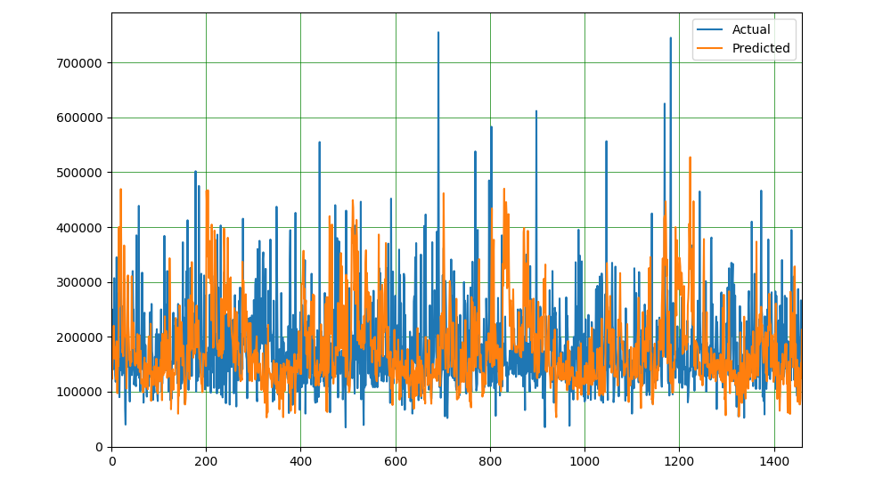
PLOTTING TRAINING DATA PREDICTION

Slide 25
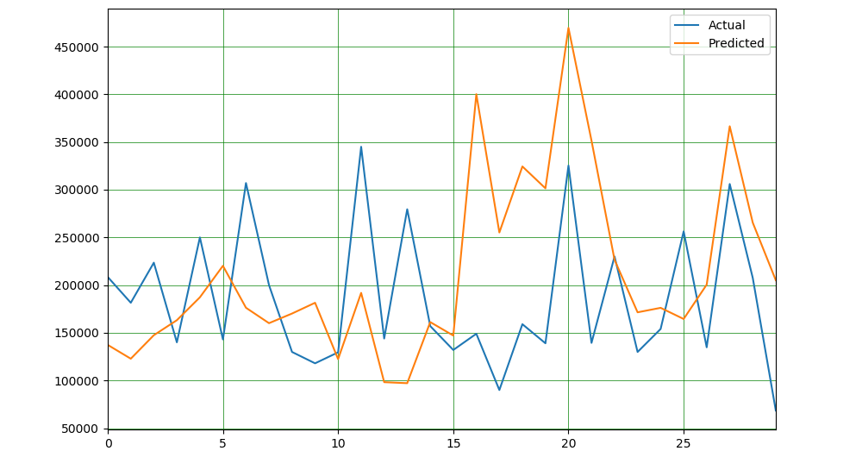
LINE GRAPH SHOWING TRAINING DATA PREDICTION (HEAD)

Slide 26
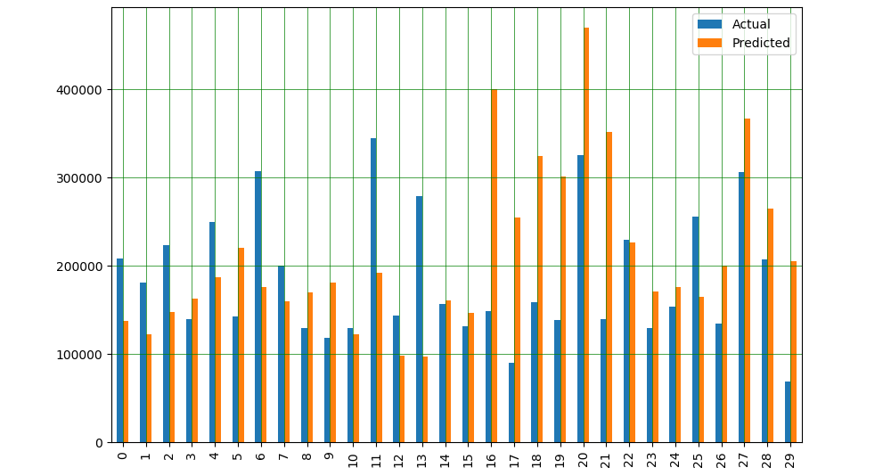
BAR GRAPH SHOWING TRAINING DATA PREDICTION (HEAD)

Slide 27
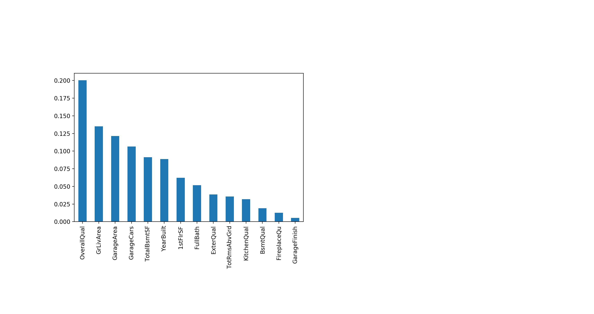
FEATURE IMPORTANCE

Slide 28
MODELS TESTED
Model | Train Score(R2)
Linear Regression | 0.802041
Lasso | 0.837162
Random Forest | 0.976609
Gradient Boosting | 0.935683

Slide 29
SELECTED MODEL METRICS
Random Forest Was Selected For Prediction Among All the Reviewed Models

Slide 30
KAGGLE SCORE
0.18612
Notes:
Ensemble methods are techniques that create multiple models and then combine them to produce improved results. Ensemble methods usually produces more accurate solutions than a single model would.

Slide 31
CONCLUSION
Feature selection can be improved upon as the remaining features were still not quite optimal.
Future work to improve prediction is to use ensemble methods to combine several methods to achieve a better prediction model.
There is room for improvement of the model with regard to the prediction technique used.
Notes:
Ensemble methods are techniques that create multiple models and then combine them to produce improved results. Ensemble methods usually produces more accurate solutions than a single model would.

Slide 32
That’s All For Now, Thank You.

